Slide 1
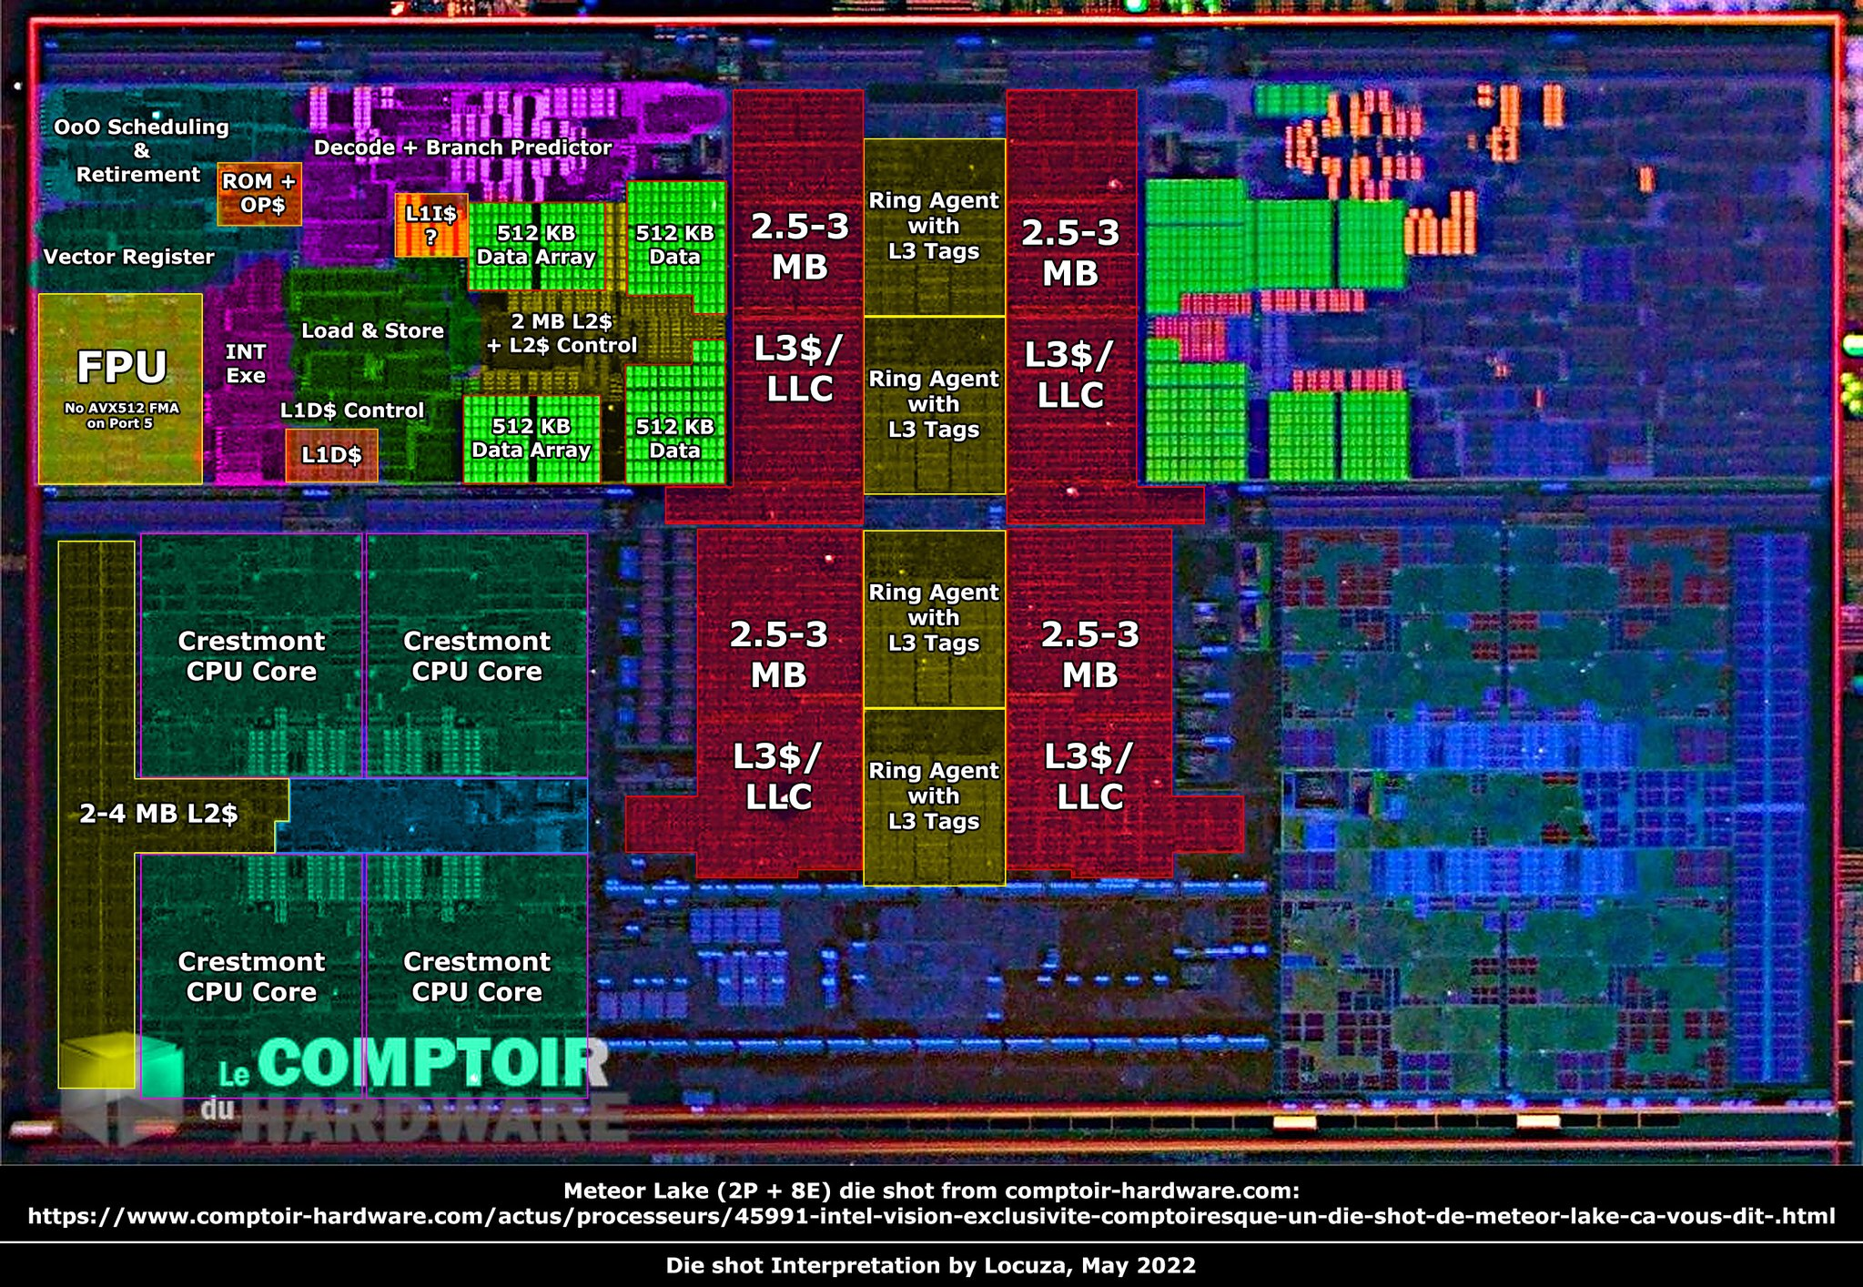
MIPS SIM
By Daniel Kuchar, Joshua Egwaikhide, Logan Magaha, and Aarush Nepali

Slide 2
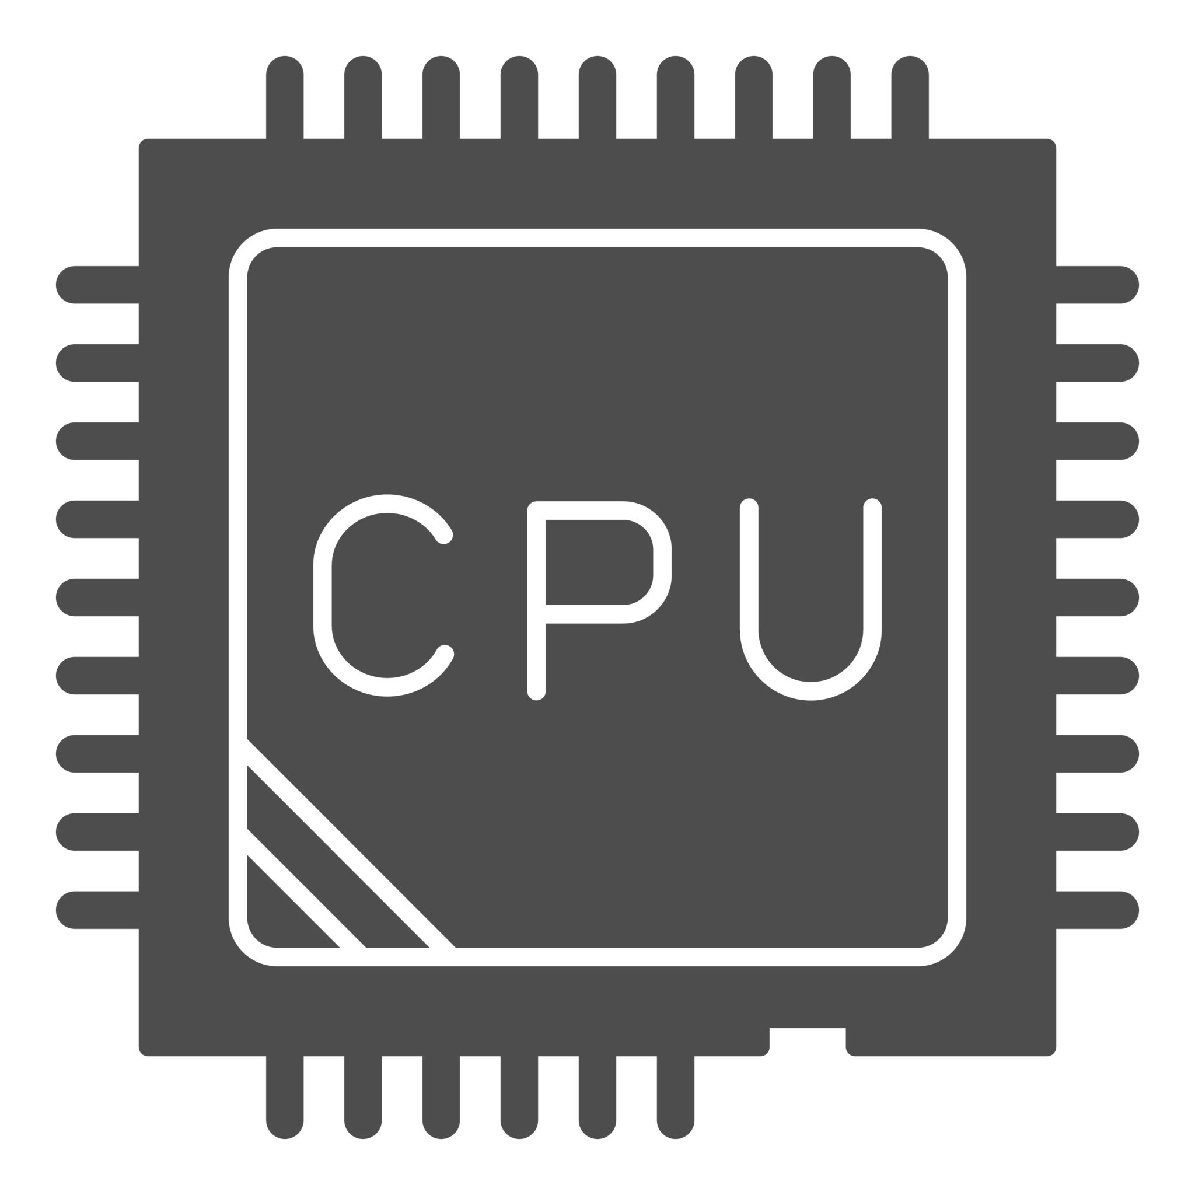
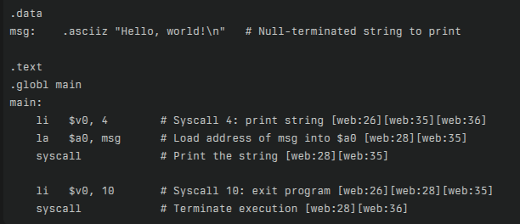
What is MIPS?
The MIPS 32‑bit instruction set architecture (ISA) is a reduced instruction set computer (RISC) design in which all general-purpose registers, data paths, and instructions are 32 bits wide, and every instruction has a fixed length of 32 bits.

Slide 3
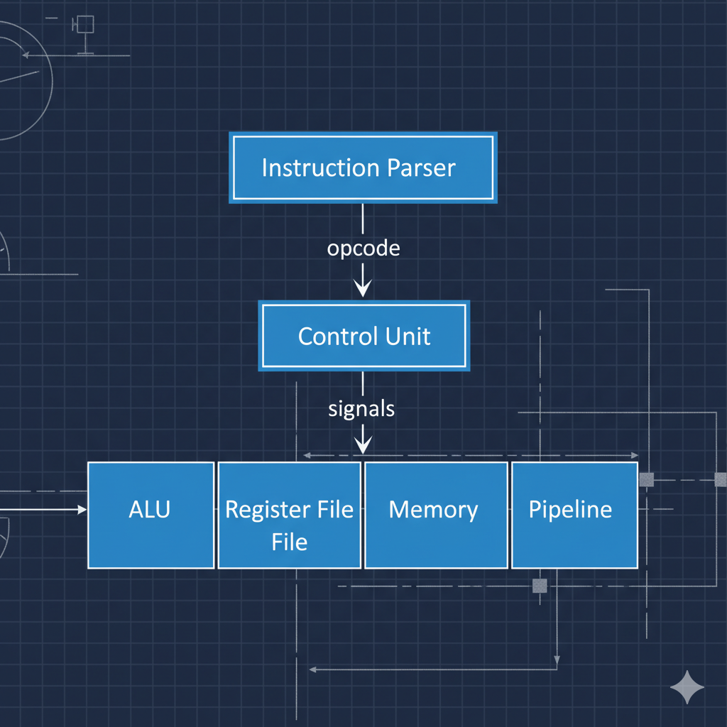
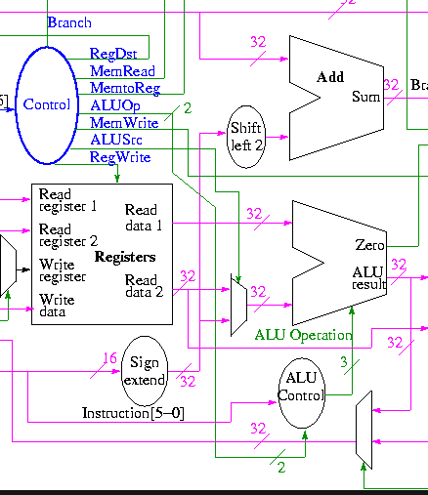

Slide 4
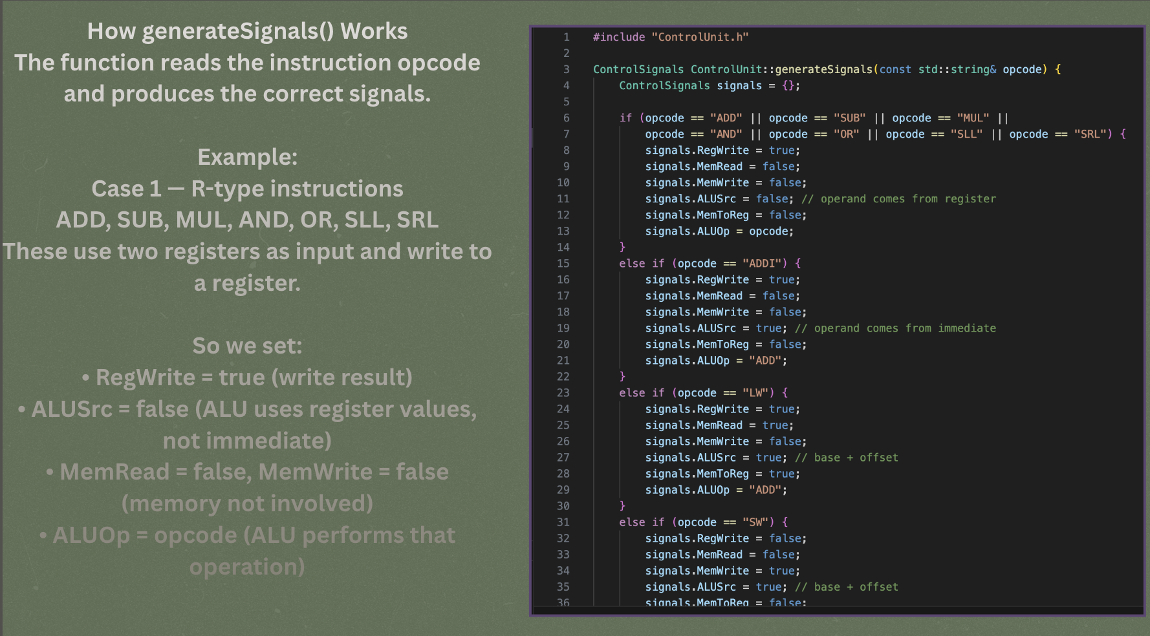

Slide 5
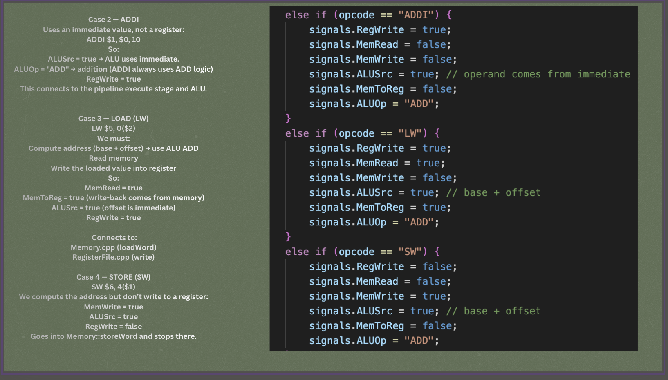

Slide 6
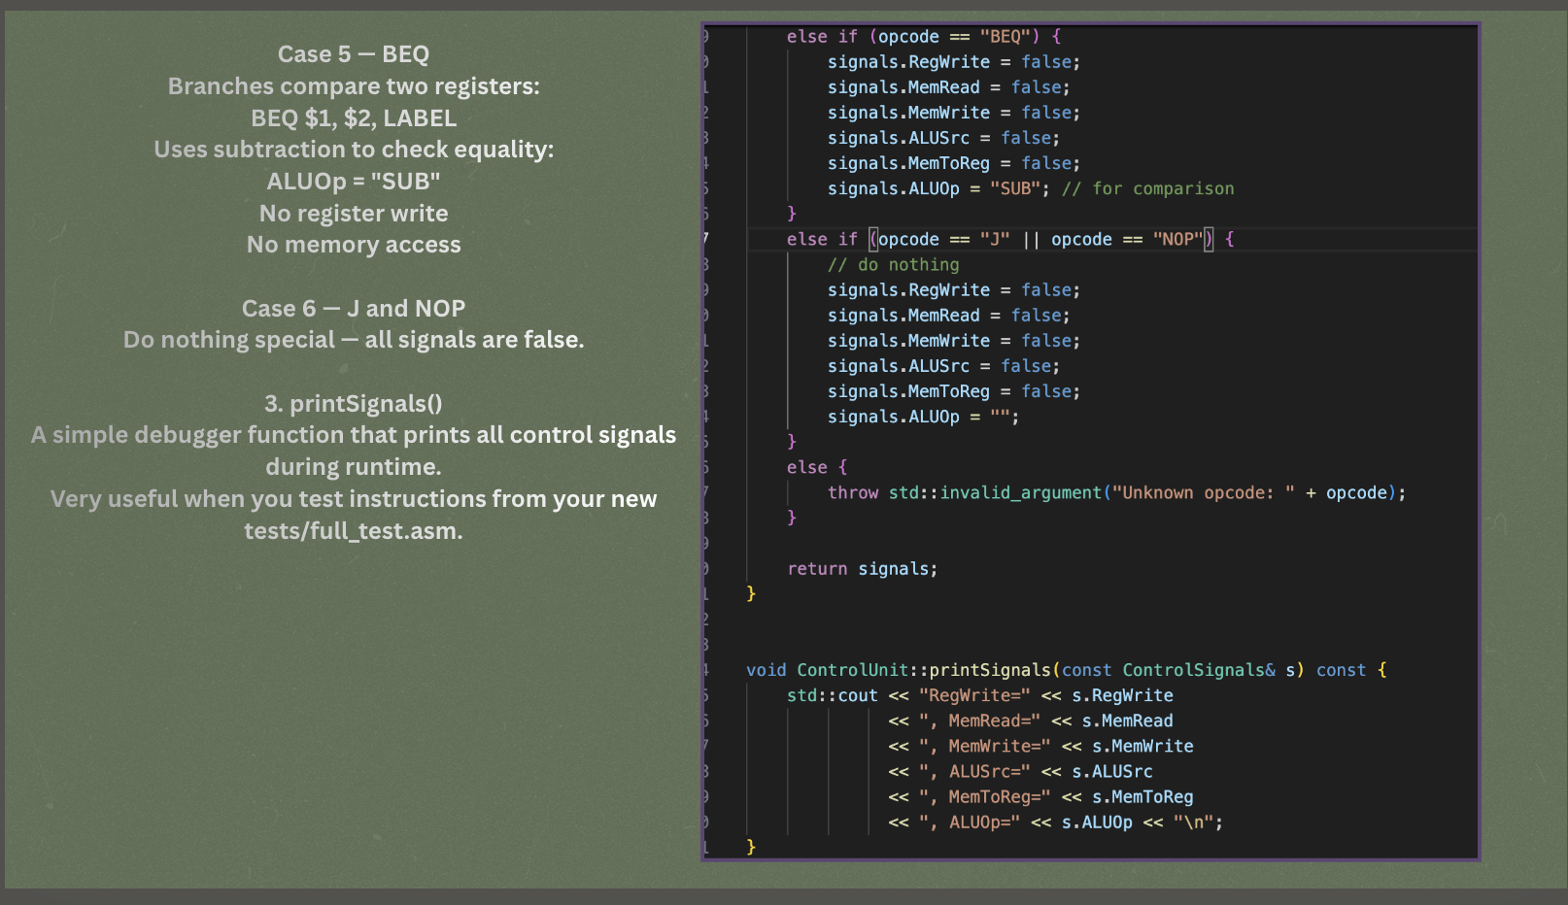
Your slides should be first if you are presenting the introduction

Slide 7
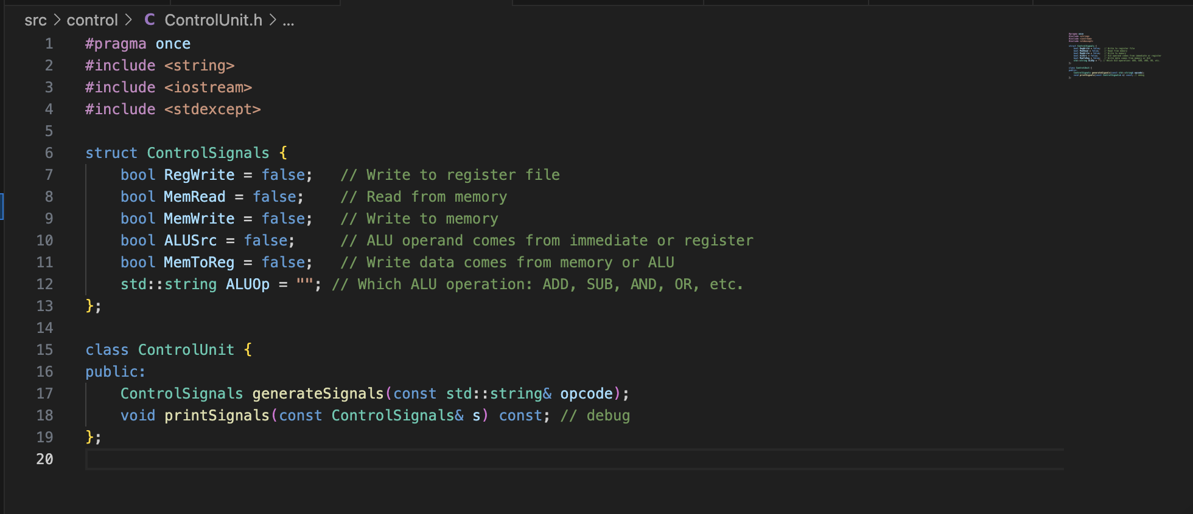
Class and Function Declarations

Slide 8
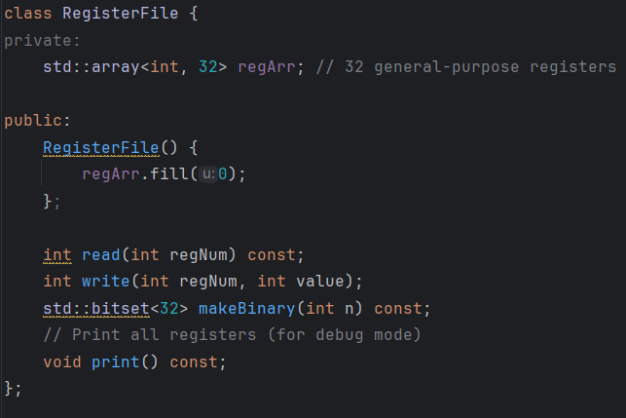
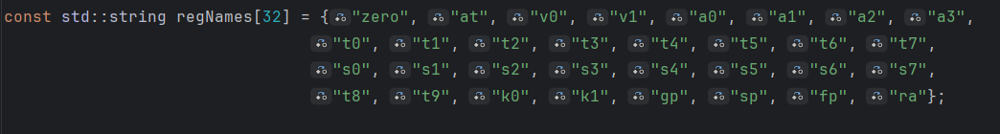
Register File
This is the RegisterFile class
It includes a array named regArr which we are using as our register.
The regNames array in the cpp file is a constant array that holds the names of every register.
The read function is how information rom the register is viewed and used.
The write function is how the register is updated.
The print function prints the information in the register. It prints the name o the register, then the value, and then the binary value, The binary value is obtained by using makeBinary

Slide 9
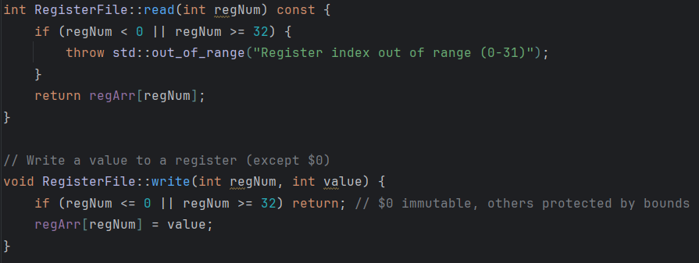
Register File

Slide 10
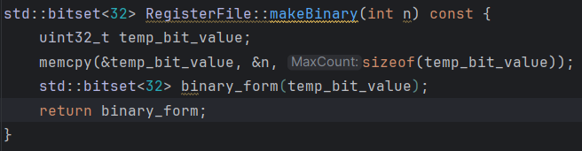
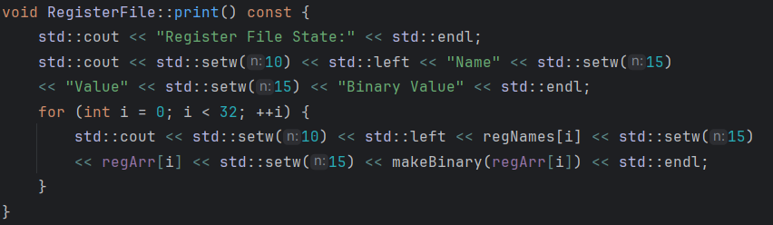
Register File

Slide 11
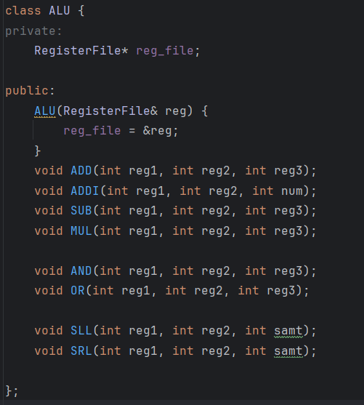
ALU

Slide 12
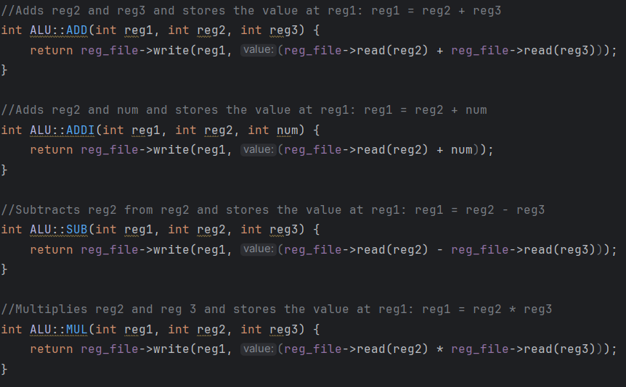
ALU

Slide 13
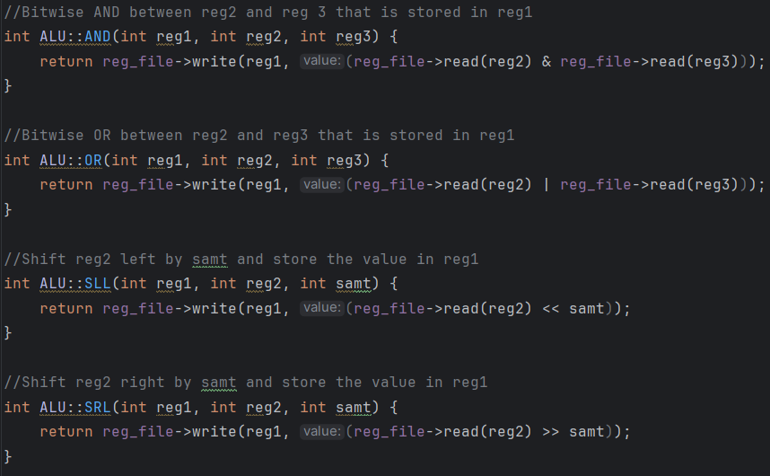
ALU

Slide 14
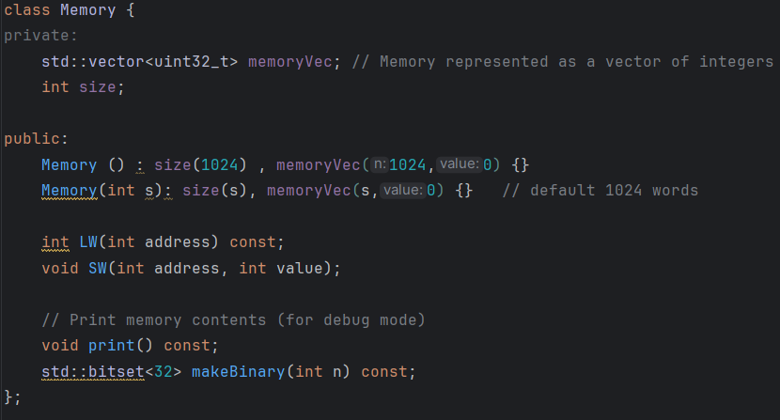
Memory

Slide 15
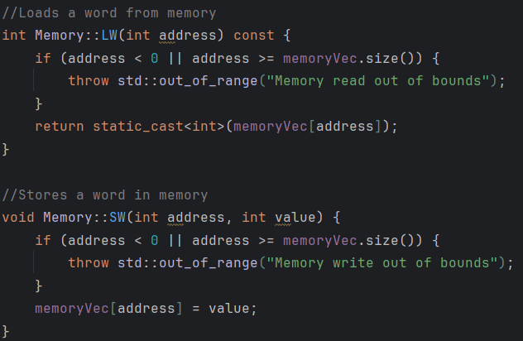
Memory

Slide 16
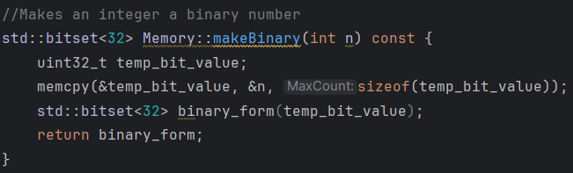
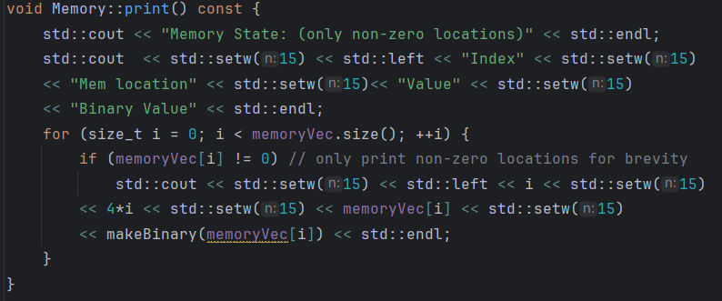
Memory

Slide 17
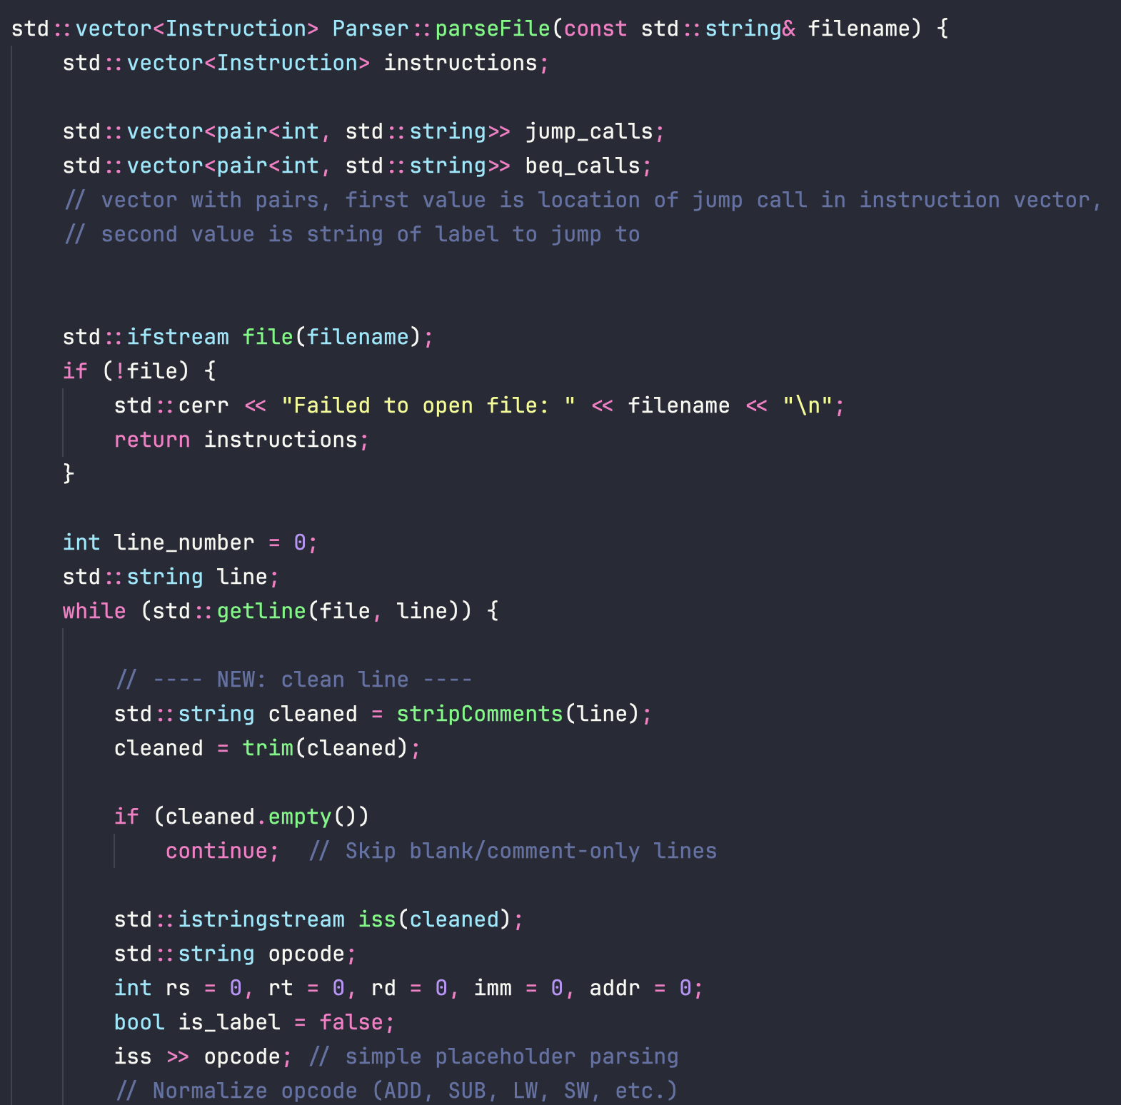
Parser

Slide 18
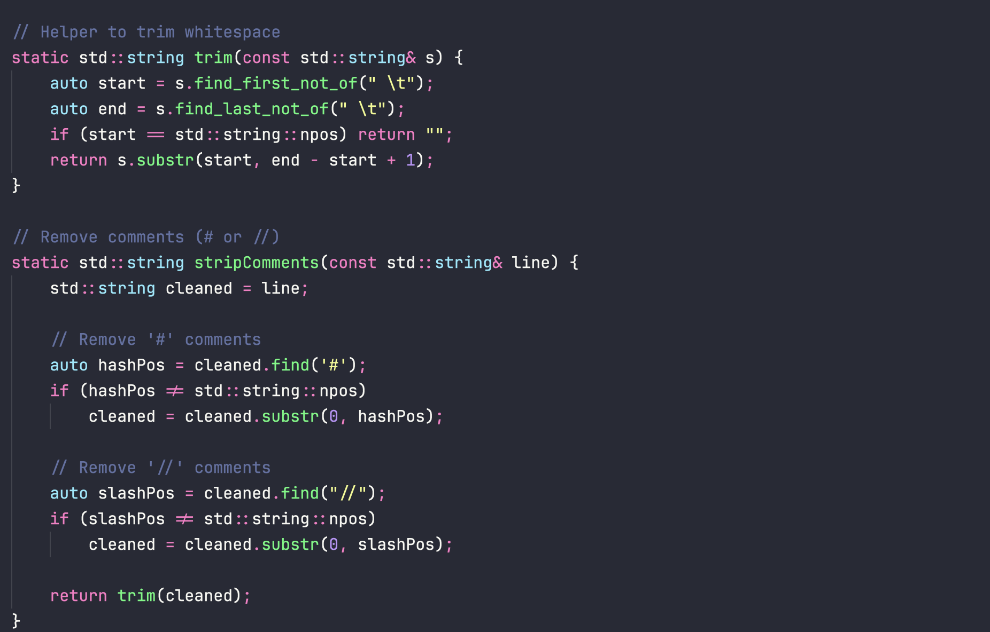

Slide 19
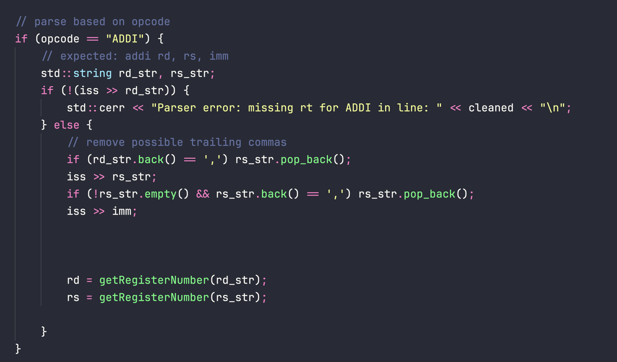
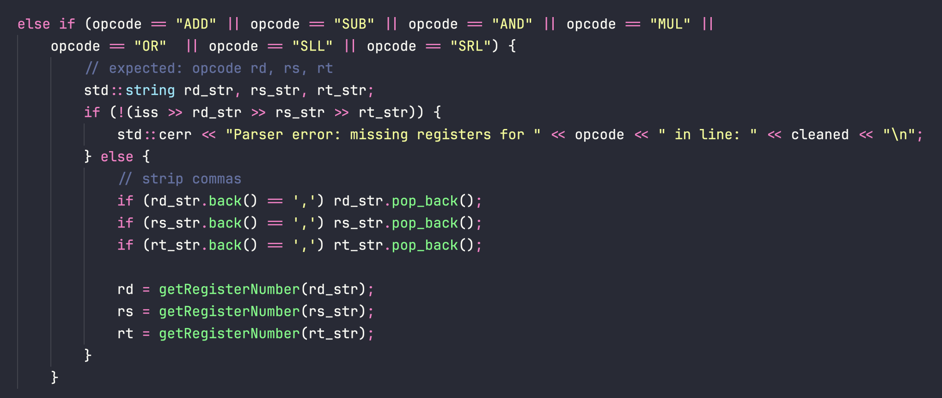

Slide 20
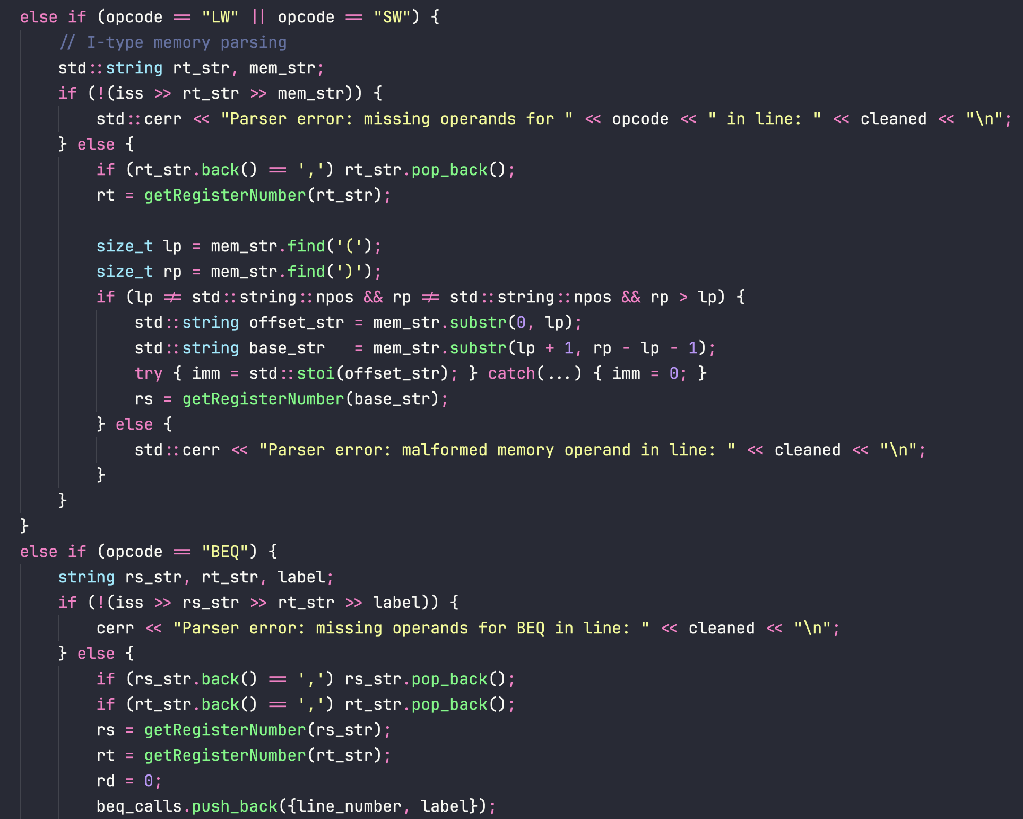

Slide 21
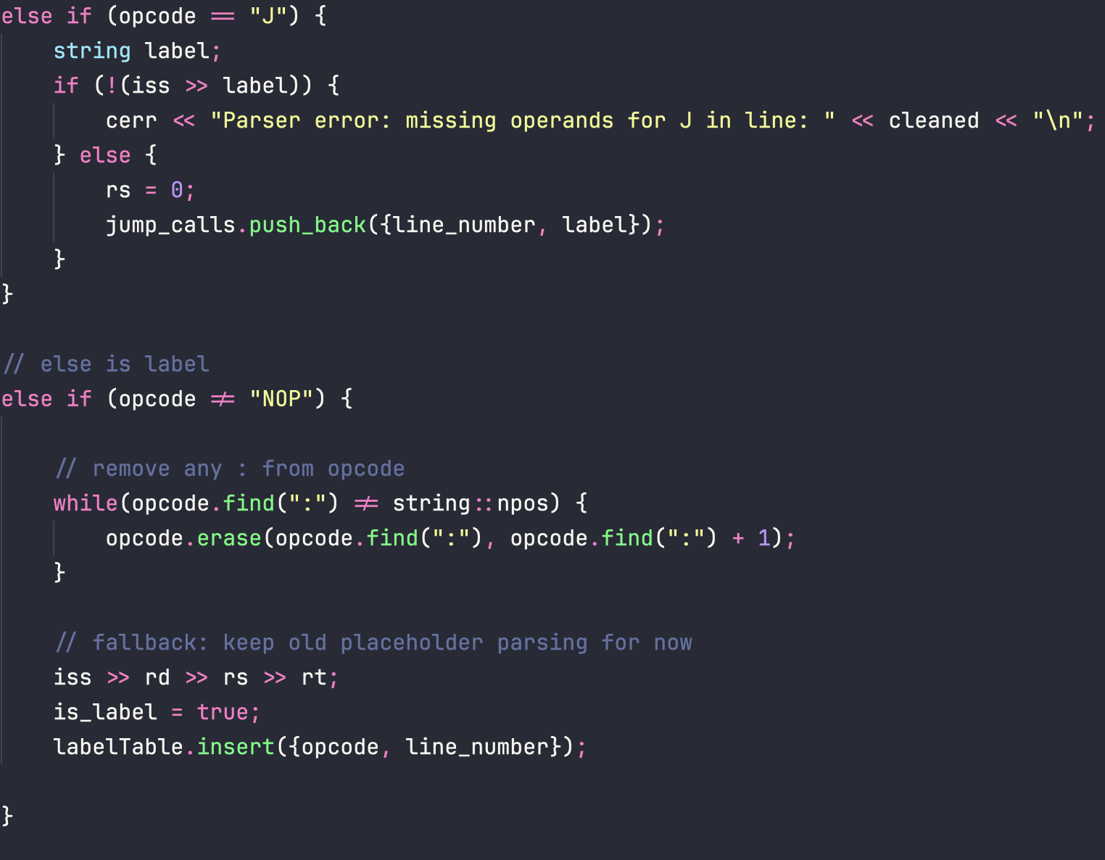

Slide 22
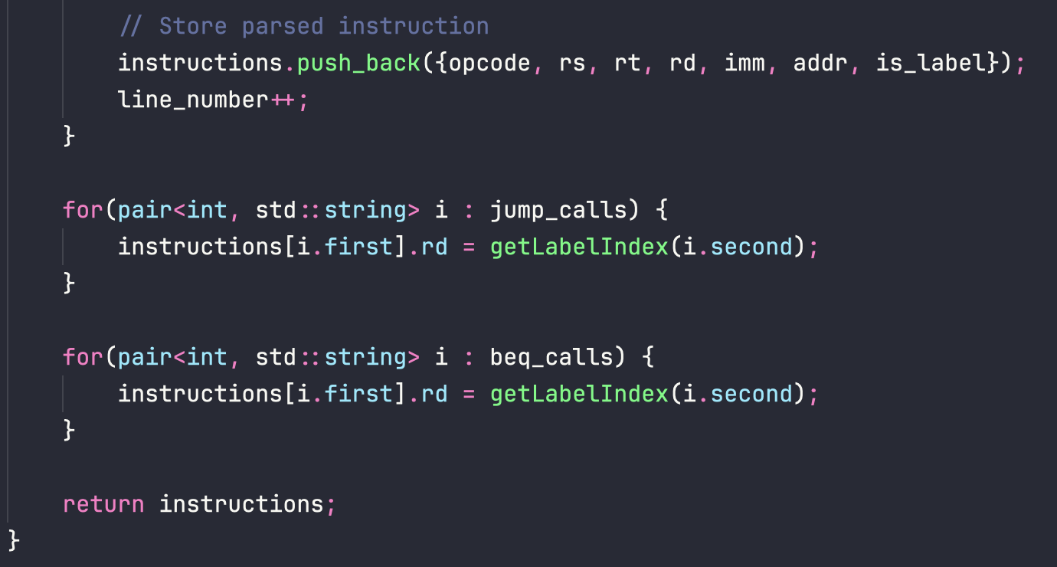

Slide 23
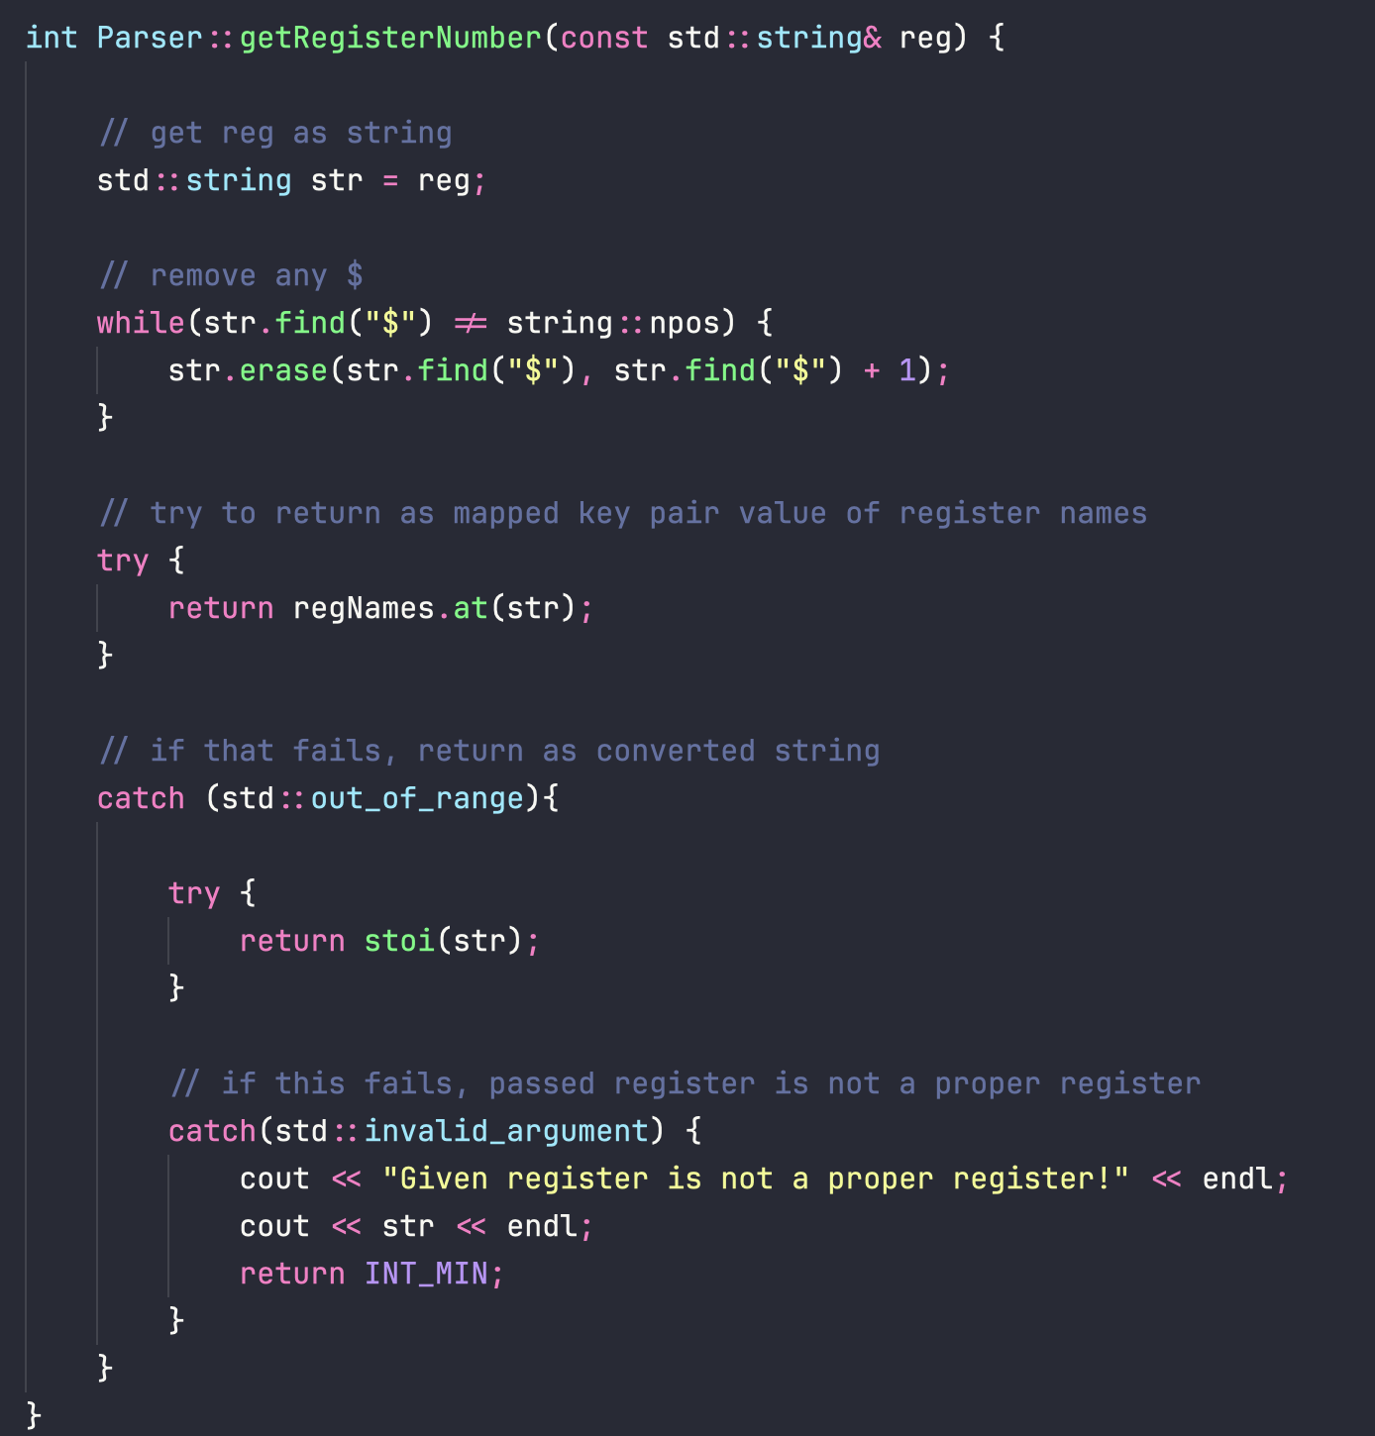
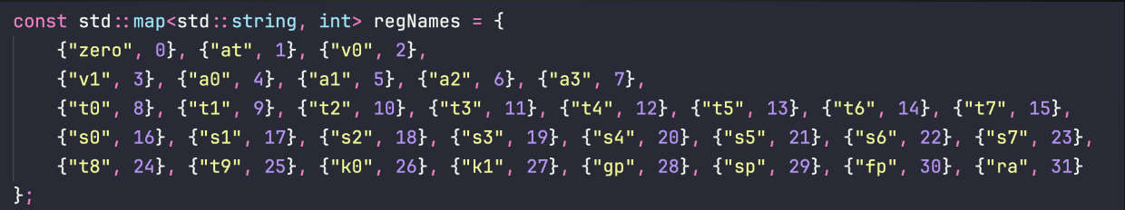

Slide 24
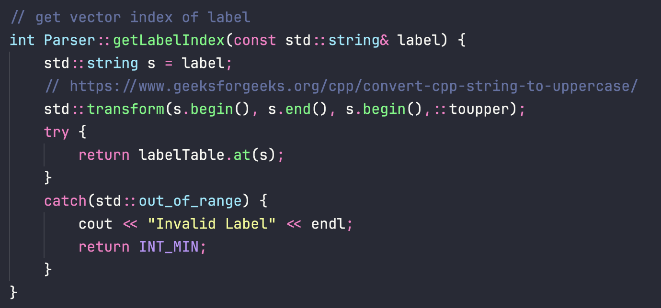

Slide 25
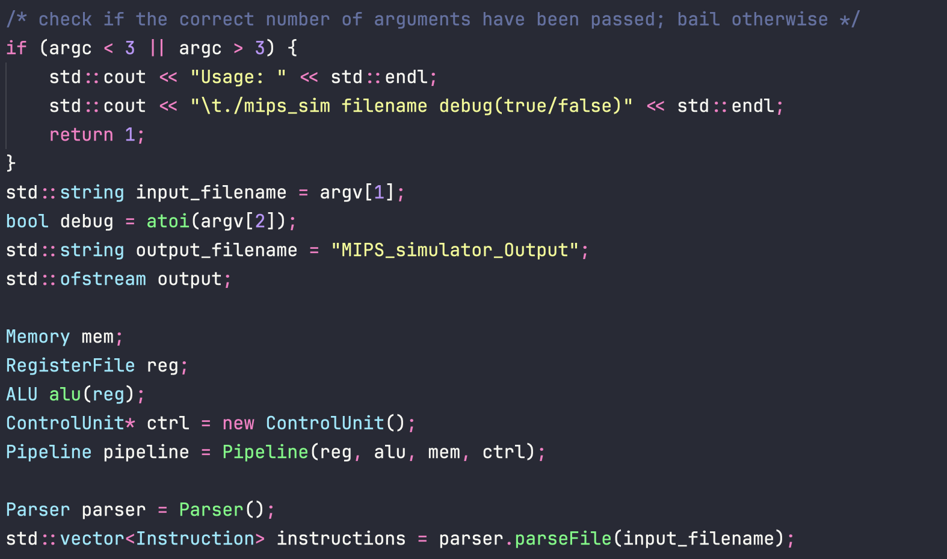
Main.cpp

Slide 26
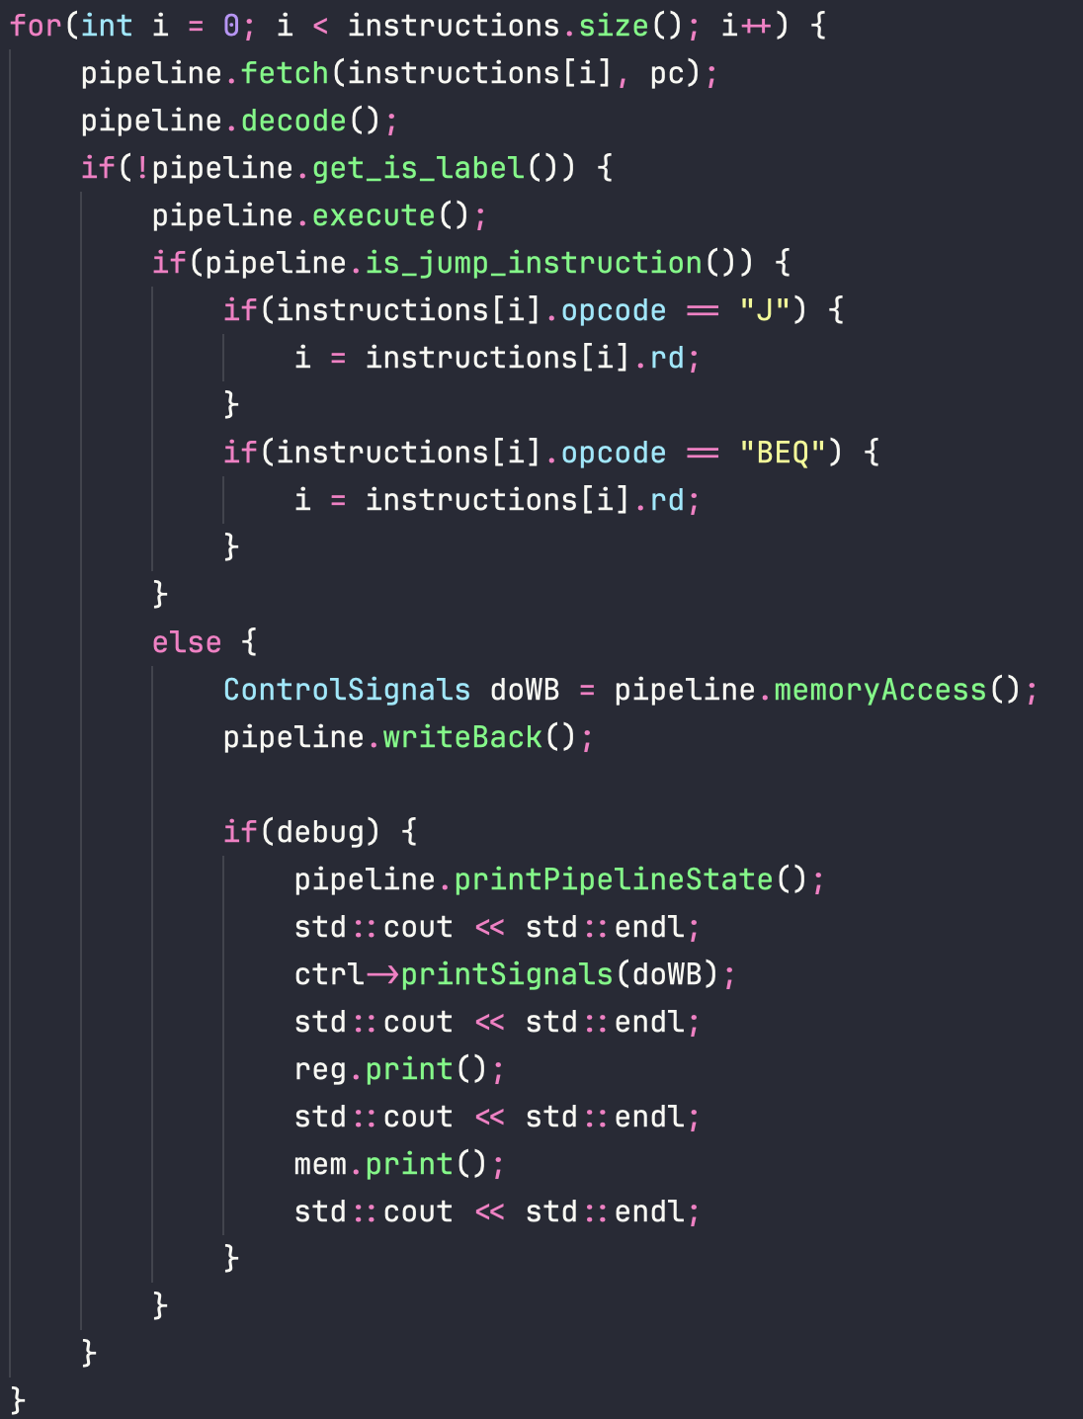
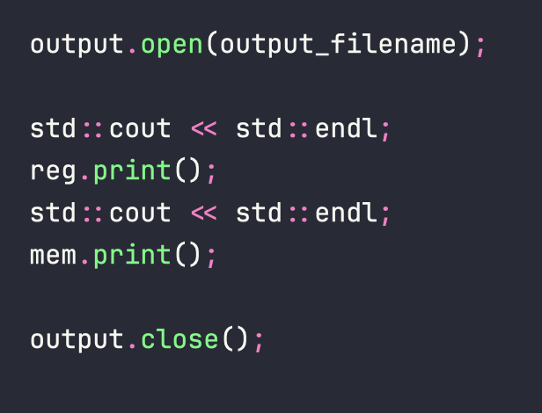
Main.cpp

Slide 27
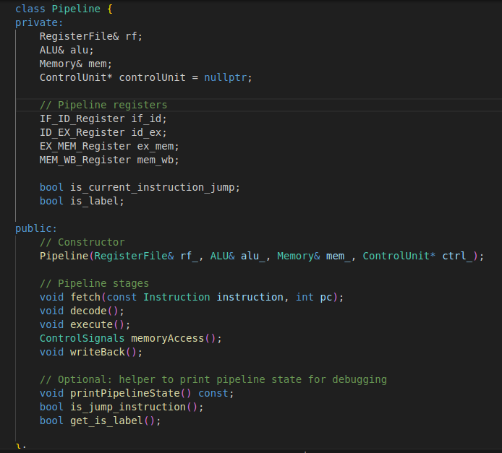
Pipeline
The Pipeline class is a C++ model of a 5-stage MIPS CPU pipeline that connects our main CPU components (register file, ALU, memory, and control unit) and moves instructions through the classic stages: fetch, decode, execute, memory access, and write-back.
// - Data and control flow through: IF → ID → EX → MEM → WB.
// - Between each pair of stages,
a pipeline register stores the outputs of one stage

Slide 28
Pipeline
IF/ID register: Holds the fetched instruction and related data as it moves from Instruction Fetch to Instruction Decode.
ID/EX register: Holds decoded instruction fields, register values, and control signals as the instruction moves from Decode to Execute.
EX/MEM register: Holds ALU results and control information as the instruction moves from Execute to Memory Access.
MEM/WB register: Holds data read from memory or ALU results as the instruction moves from Memory Access to Write Back.

Slide 29
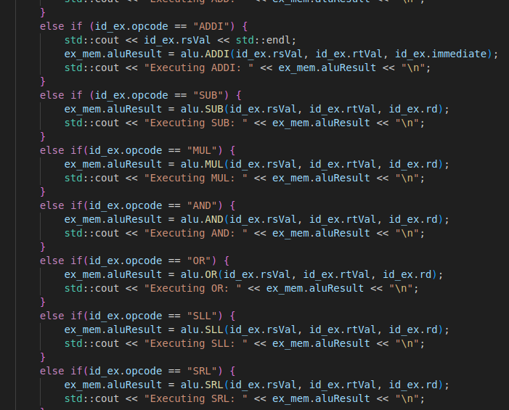
Pipeline

Slide 30
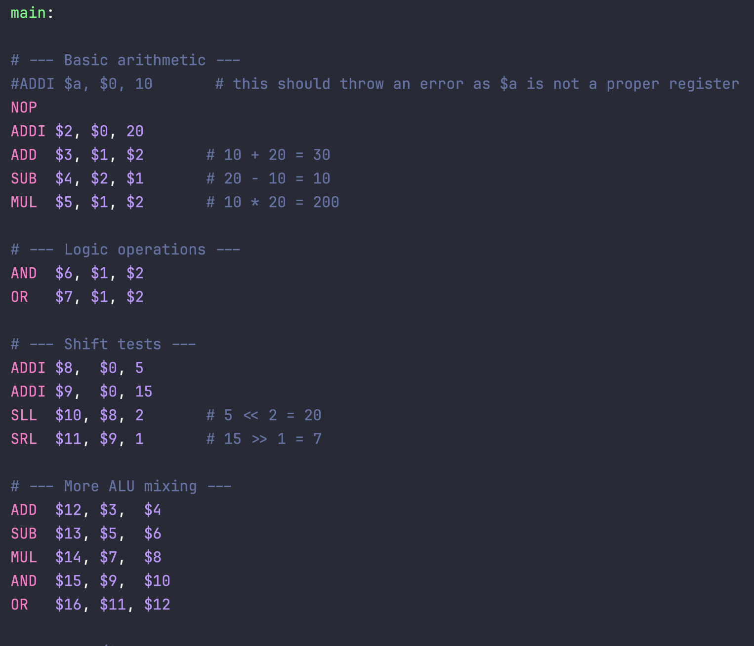
Input

Slide 31
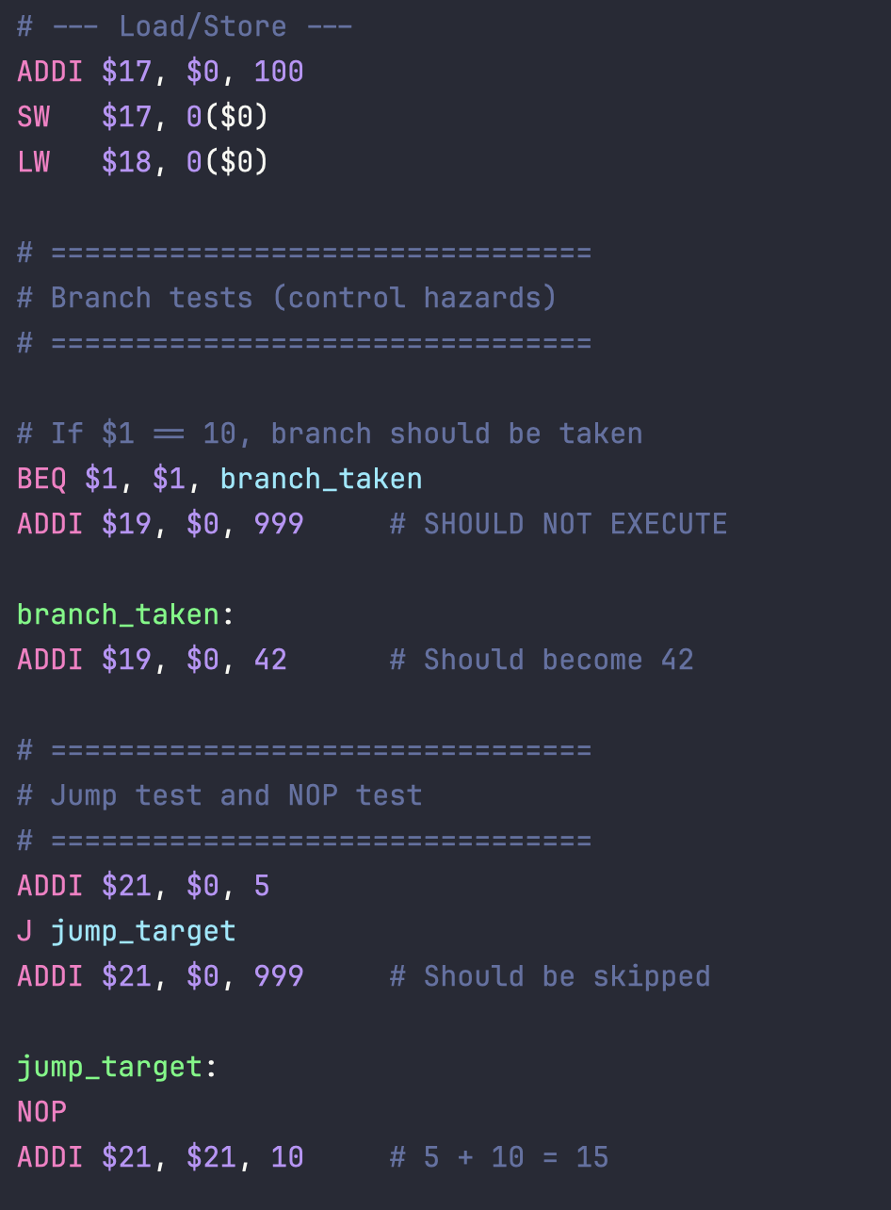
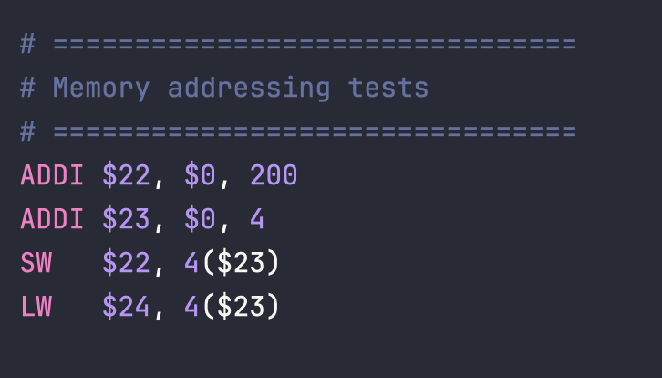
Input

Slide 32
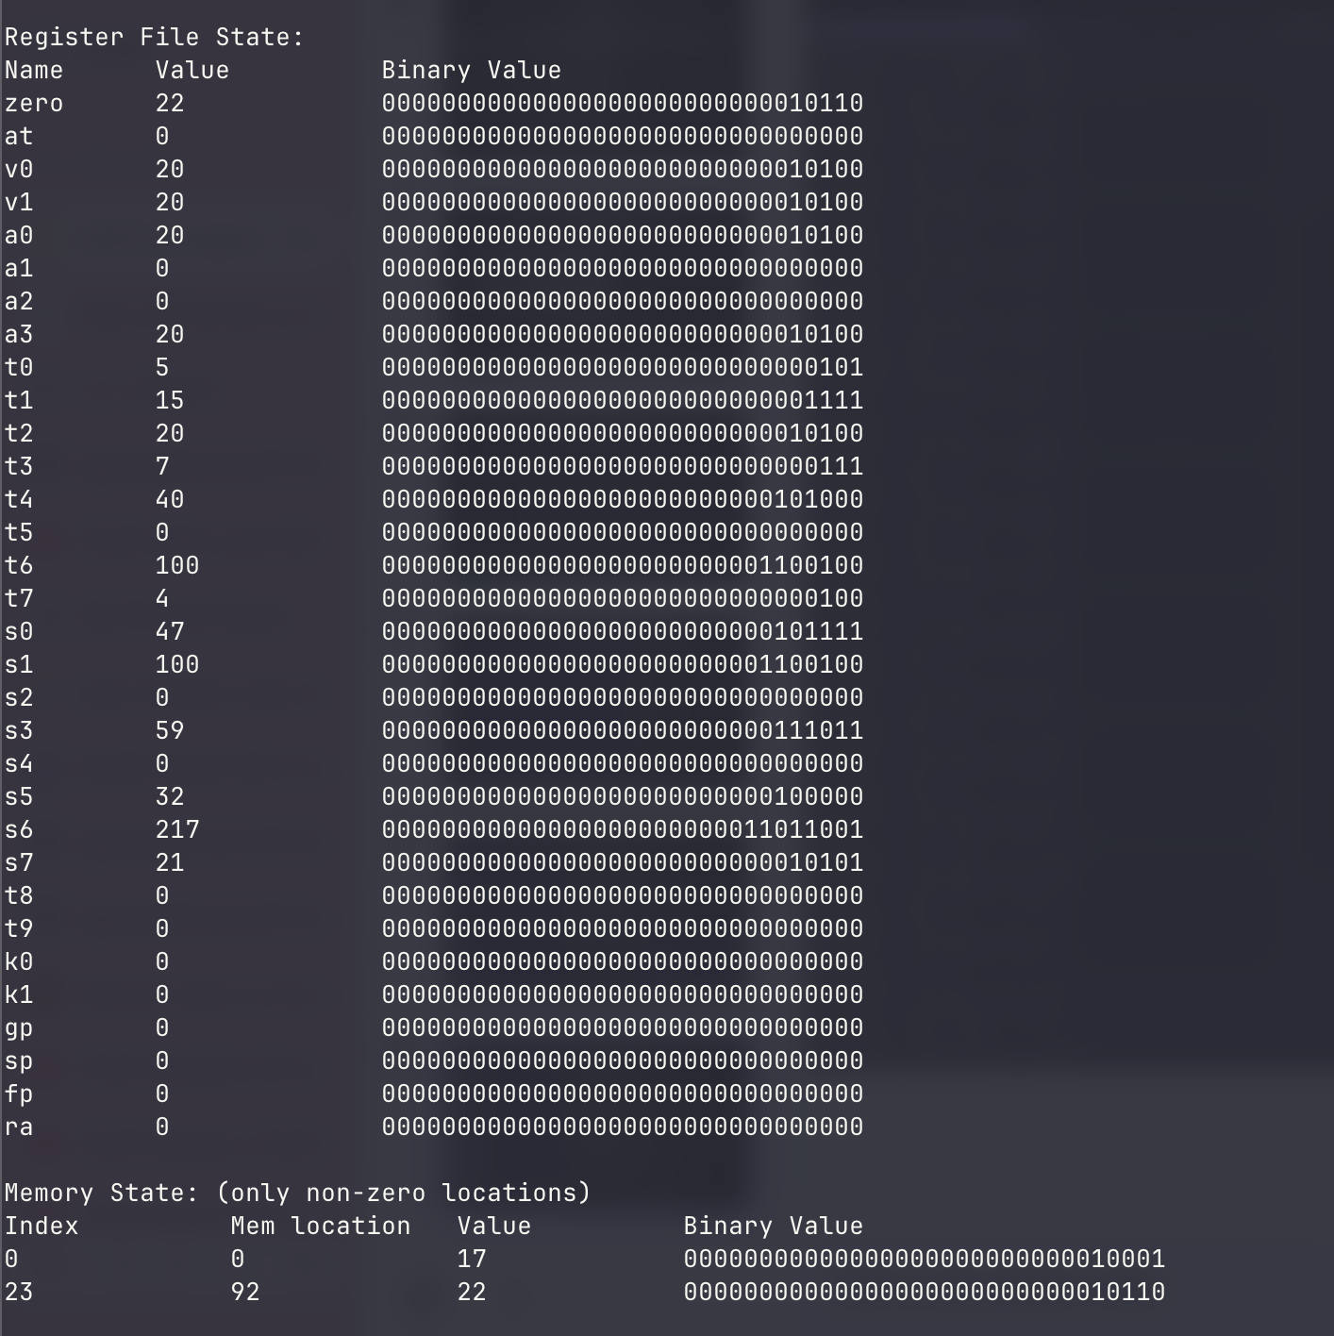
Output

Slide 33
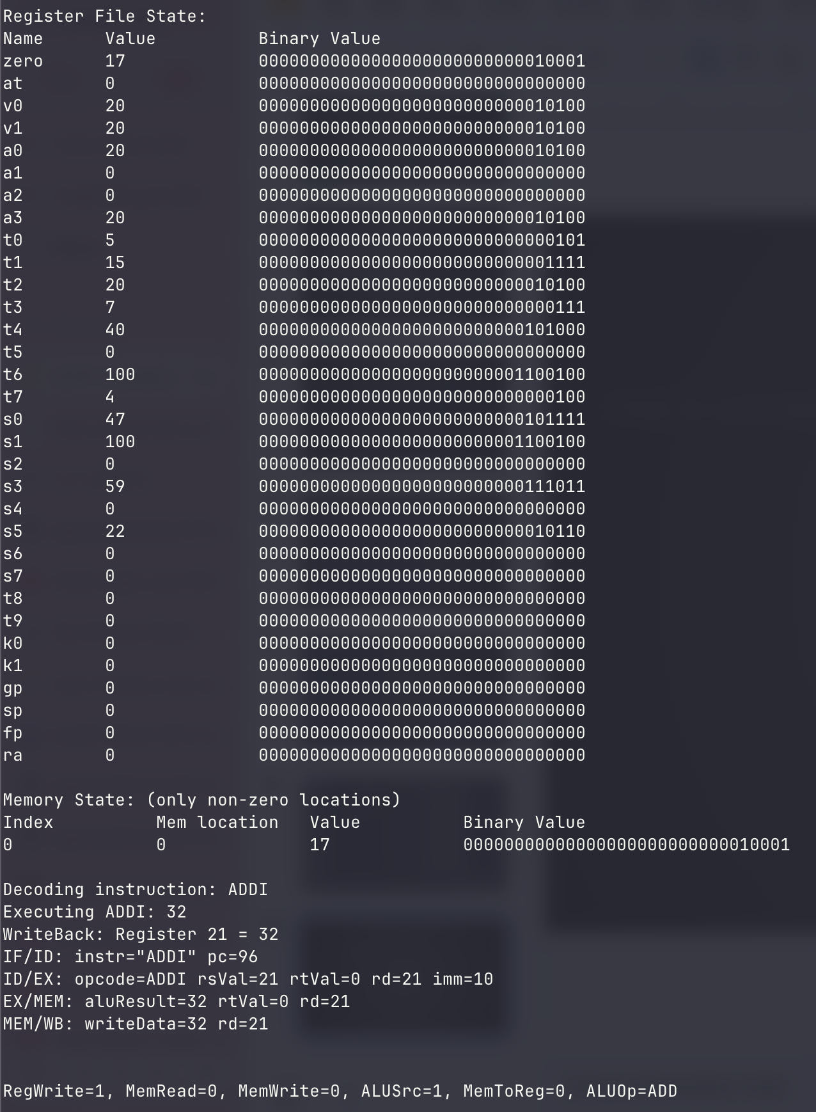
Output (Debug)

Slide 34
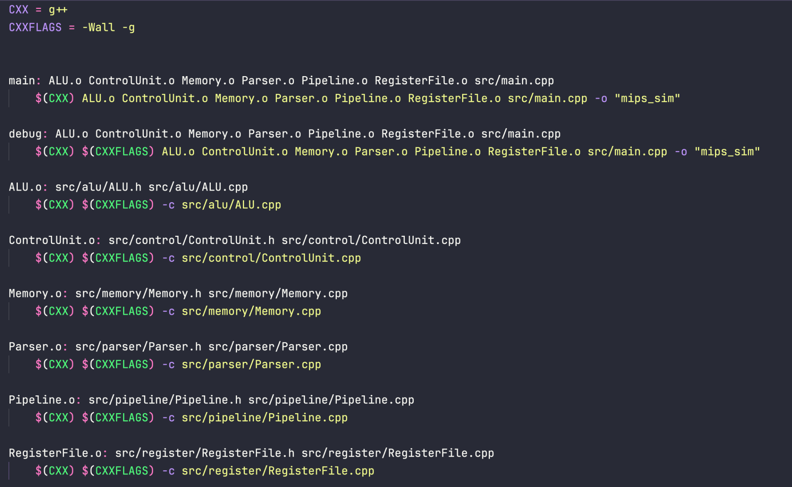
Building with Make

Slide 35
Any Questions?

